Slide 1
MODELLING A BAXTER ARM THAT PICKS A BALL AND DROPS INTO A BASKET
Pradeep Gopal | Sahana Anbazhagan
December 4, 2019

Slide 2
Outline

Slide 3
Outline
The idea is to model a Baxter robotic arm to pickup a ball from a fixed point and drop it inside a box placed at different positions inside the workspace of the robot by formulating the forward and inverse kinematics of the robot.

Slide 4
Motivation

Slide 5
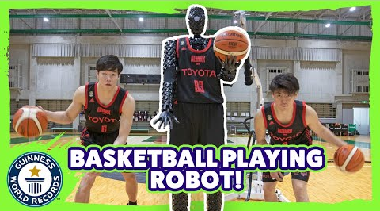
Motivation
Sports Industry – cue robot by Toyota already in place
Manufacturing Industry
Friendly robot to clean up your trash

Slide 6
Robot Description

Slide 7
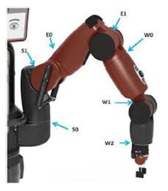
Baxter Robotic Arm
Developed by Rethink Robotics
Best choice to be used in a crowded environment.
Ability to sense potential collisions early and can reduce the force before the impact
Human sized humanoid robot with 7 DOF
All joints are revolute
Spherical wrist – more advantage to pick and drop the ball

Slide 8
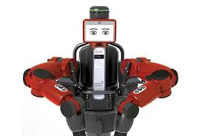
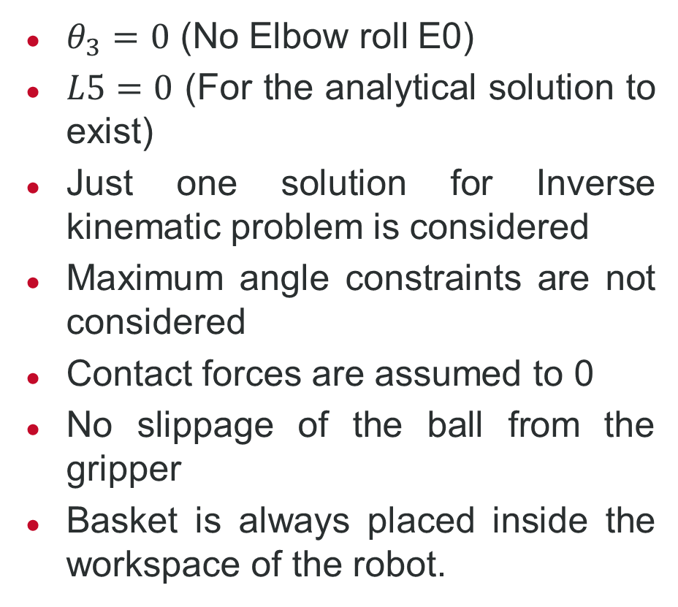
Assumptions
$θ_{3}=0$ (No Elbow roll E0)
$L5=0$ (For the analytical solution to exist)
Just one solution for Inverse kinematic problem is considered
Maximum angle constraints are not considered
Contact forces are assumed to 0
No slippage of the ball from the gripper
Basket is always placed inside the workspace of the robot.

Slide 9
Simulations

Slide 10
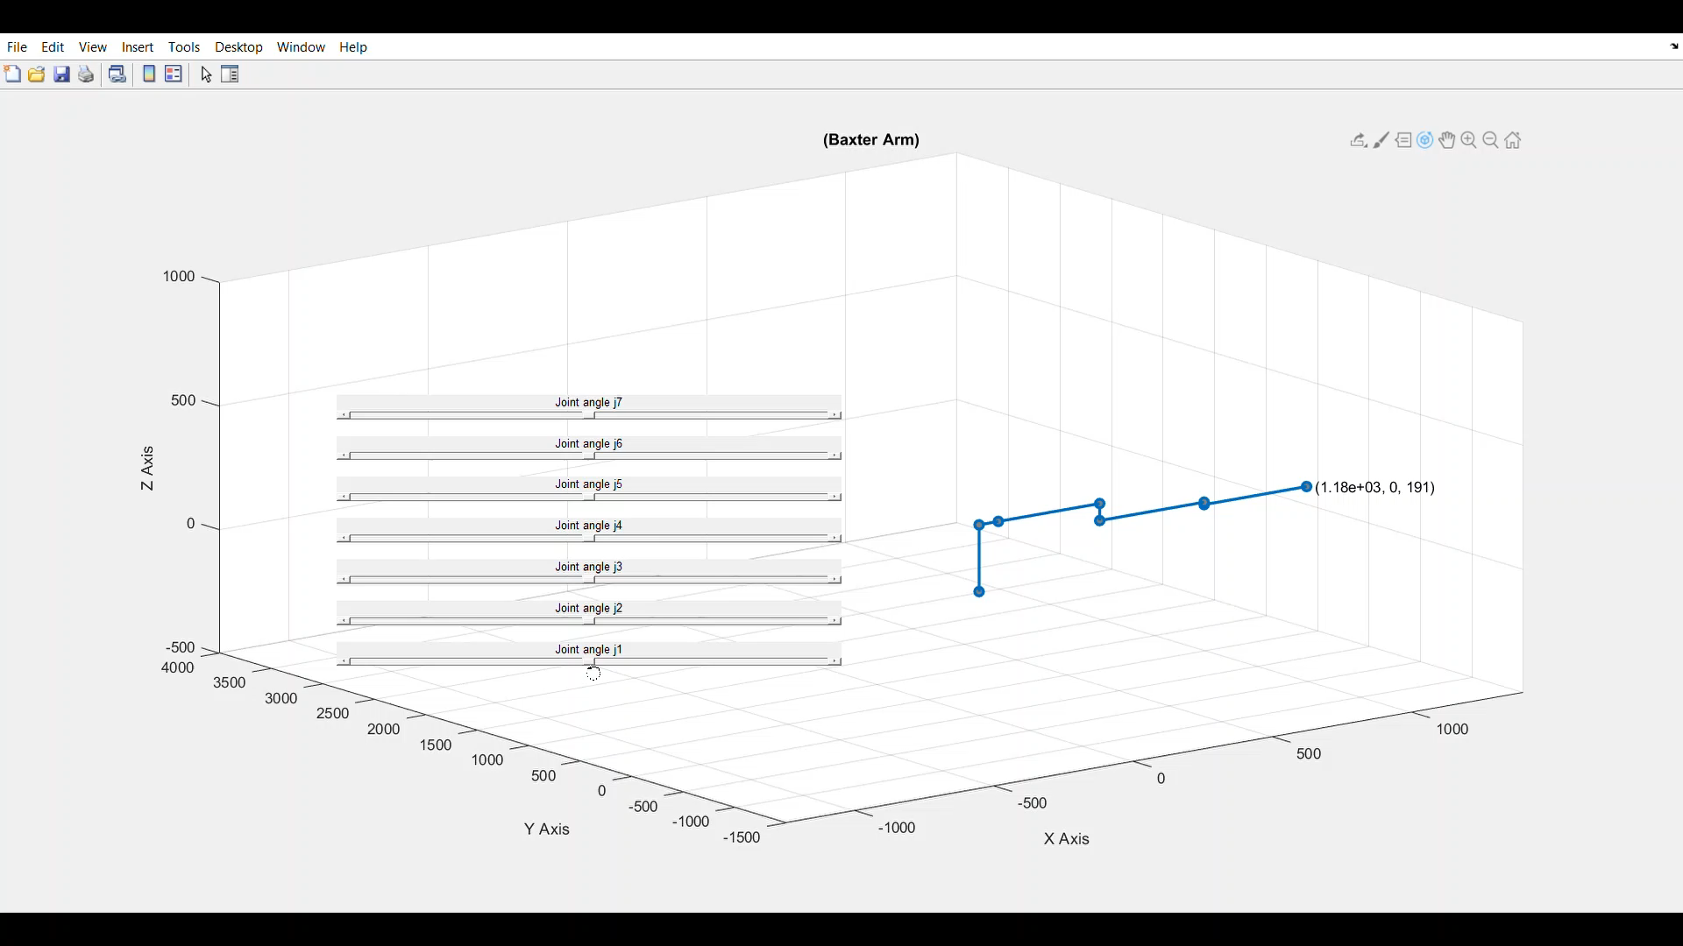
Baxter Robotic Arm – 7 DOF

Slide 11
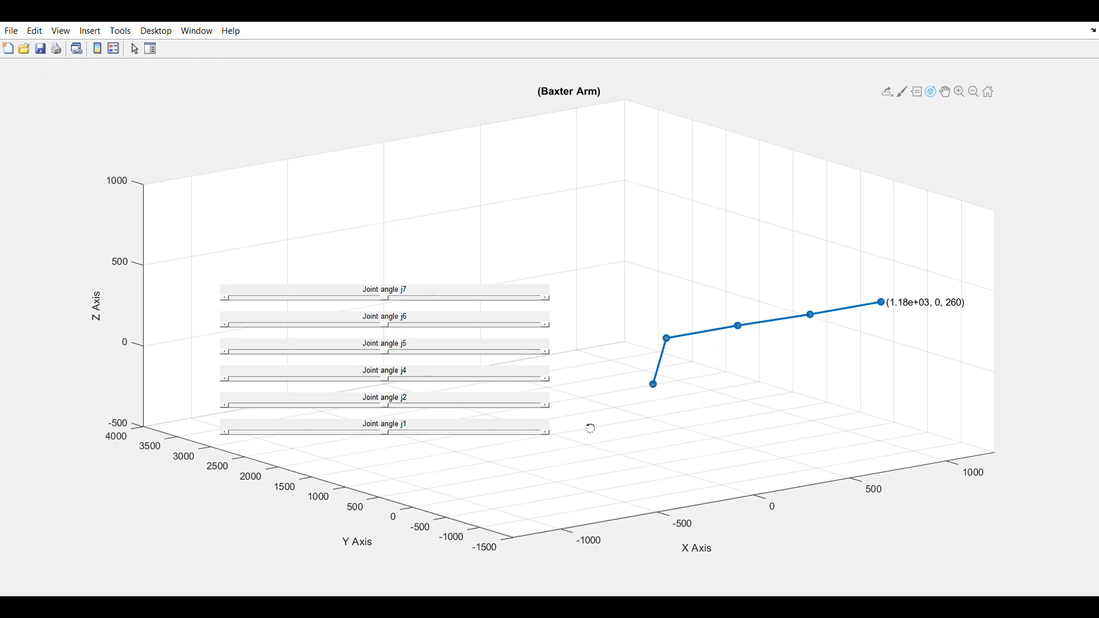
Baxter Robotic Arm – 6 DOF

Slide 12
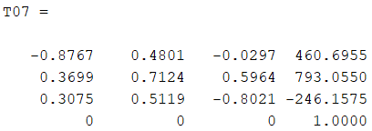
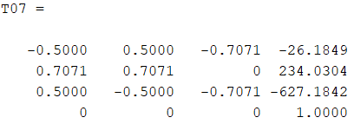
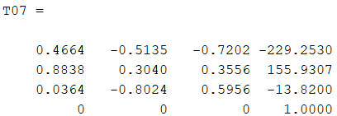
Validation – 6 DOF Forward Kinematics
Transformation matrix
Joint Angles
[50,0,35,45,35,45]
[45,45,45,45,45,45]
[35,45,95,45,95,45]

Slide 13
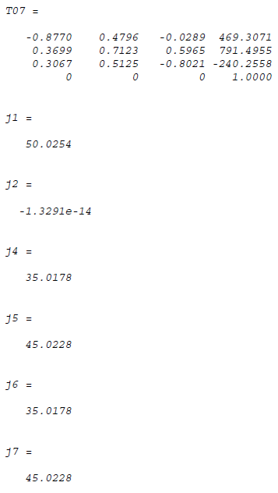
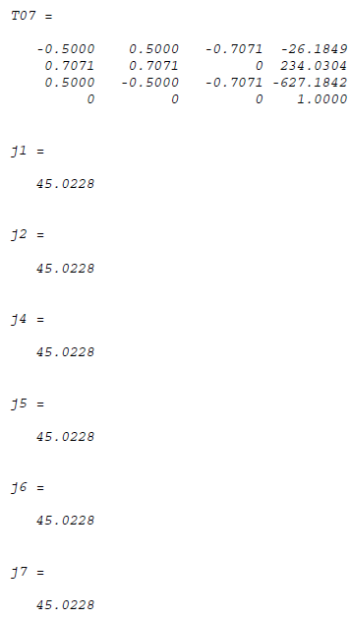
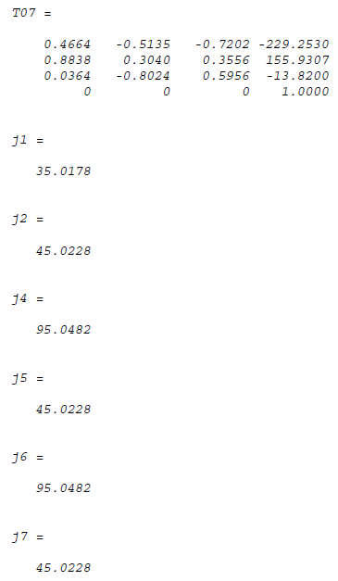
Validation – 6 DOF Inverse Kinematics

Slide 14
Next Step

Slide 15
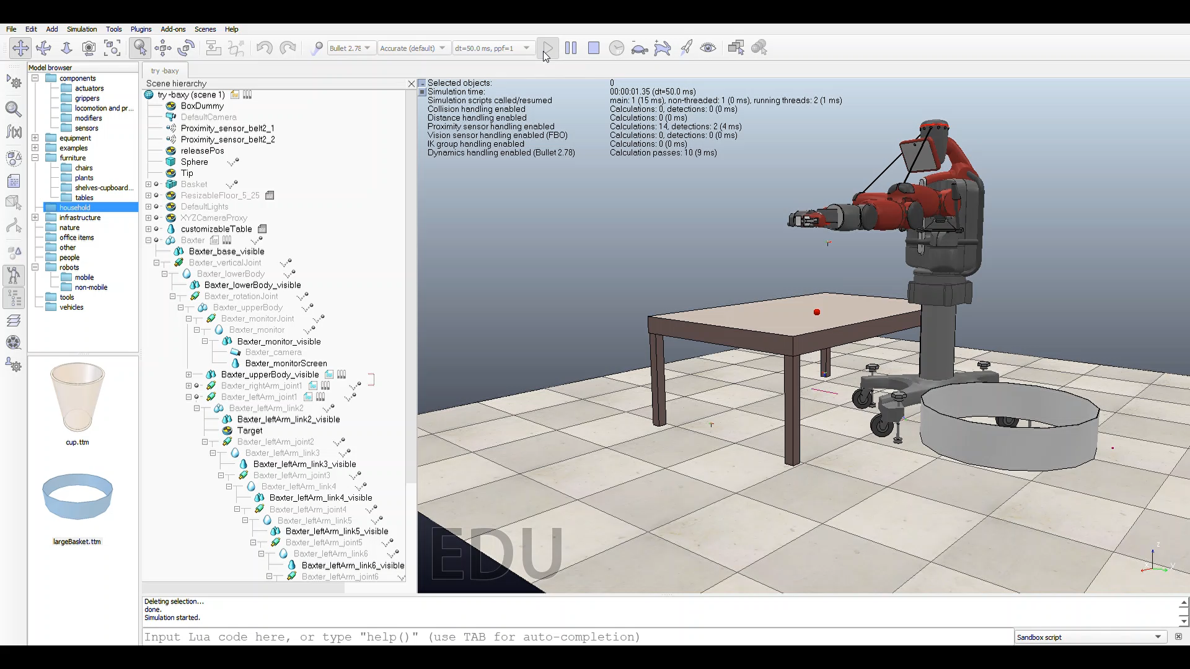
Vrep Simulation

Slide 16
Questions?

Slide 17
Pradeep Gopal | Sahana Anbazhagan
pradeepg.umd.edu

